Slide 1
Networking Climate
Isaac Delgado

Slide 2
Initial Plan
Raspberry Pi
Heating Aspect
API usage
Rain
An Actual Tank

Slide 3
Things I did have
Raspberry Pi
Heating Pad
Qunqi DHT11 Sensor (temperature & humidity)

Slide 4
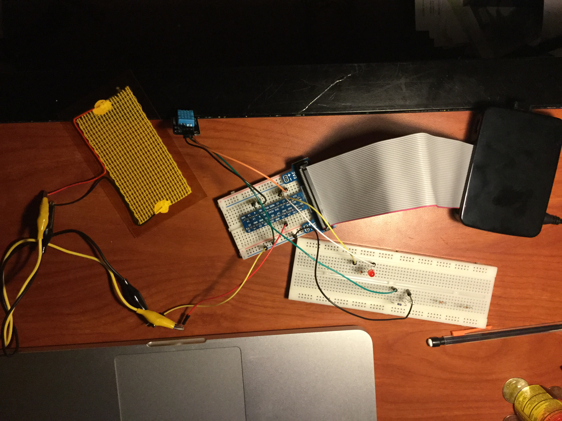

Slide 5
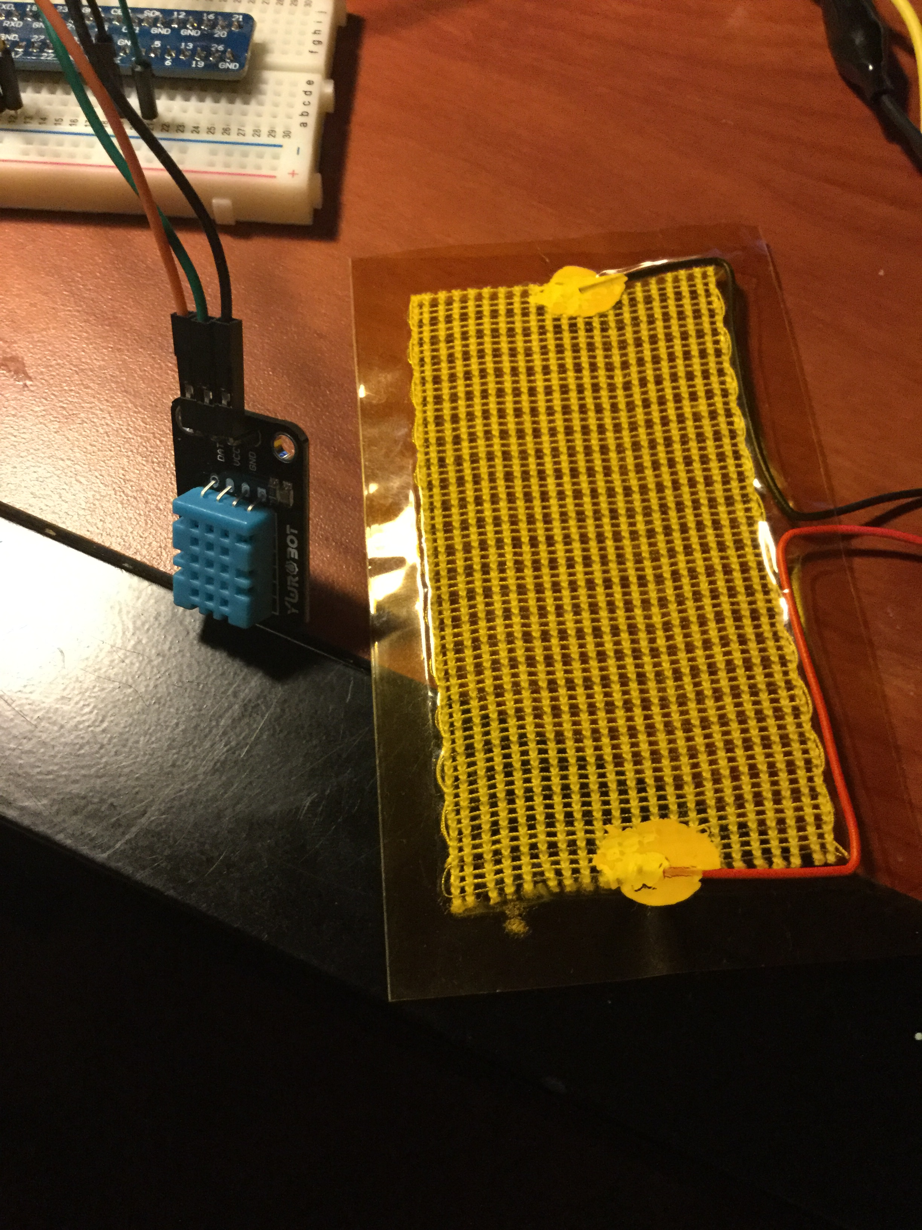

Slide 6
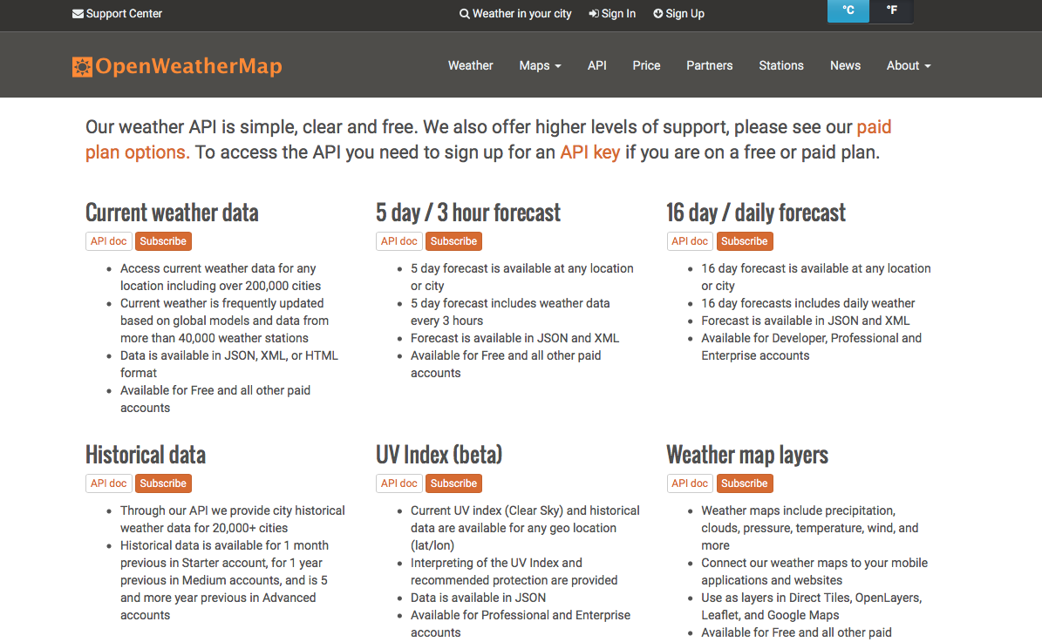
API
OpenWeatherMap

Slide 7
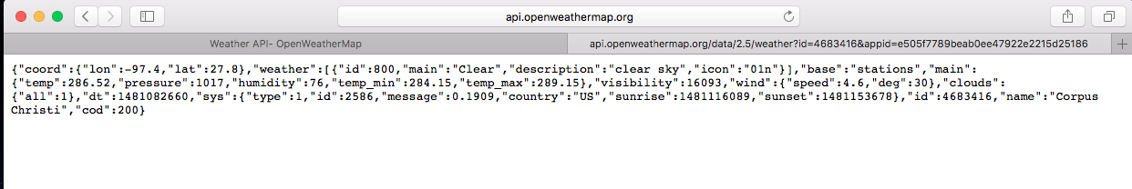
Using API
http://api.openweathermap.org/data/2.5/weather?id=4683416&appid=e505f7789beab0ee47922e2215d25186
This is how you use the API, via URL, this was the current weather for Corpus Christi when I made this presentation

Slide 8
Program Structure
I had 1 python program, 1 C++ program, and 1 text file.
Python code used the API (used python because it was easier) to get weather information. Temperature was extracted and saved in text file
C++ program extracted the temperature in the text file and controlled the temperature sensor according to the temperature previously saved

Slide 9
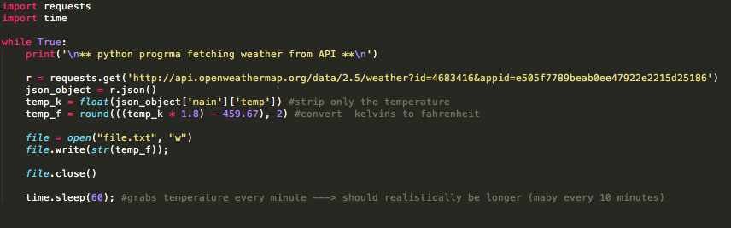
Python To extract API info

Slide 10
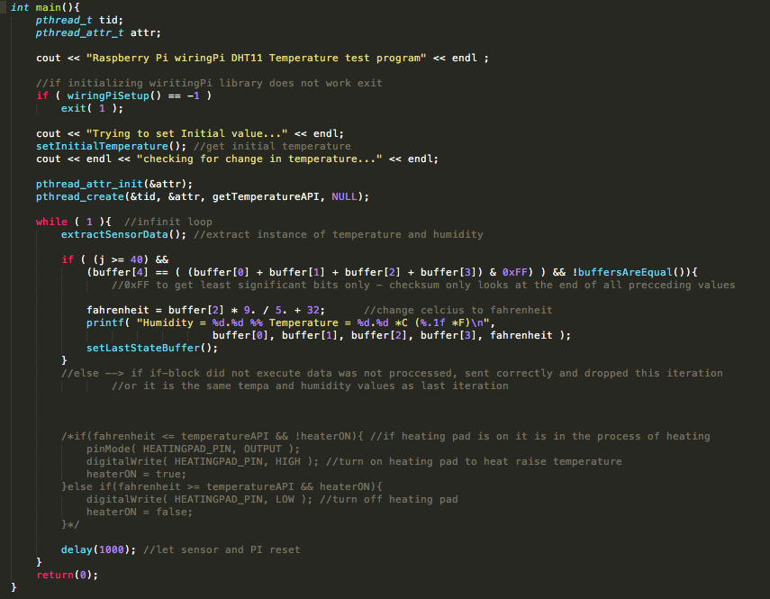
Main Program

Slide 11
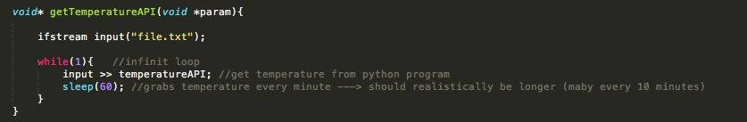
2nd Thread
This Thread in the main program continuously grabs the value in “file.txt” produced from the API
This thread sleeps, in order to let the API update the text file. (Realistically we would make it sleep longer, weather temperature does not change very quickly)

Slide 12
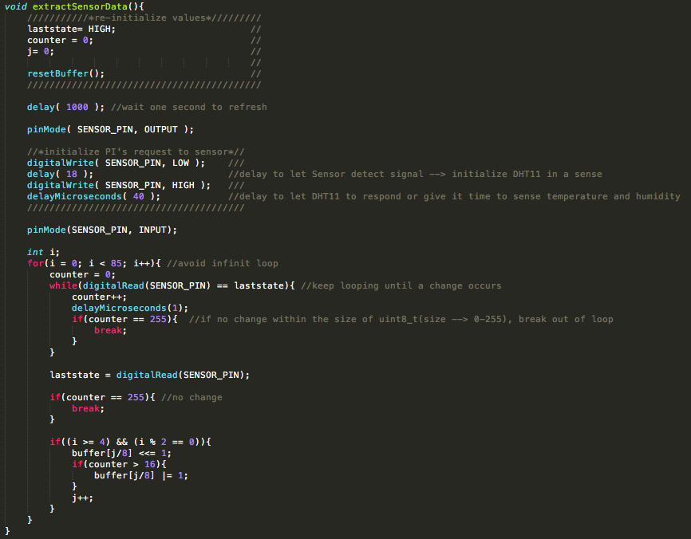
Extracting Temp & Humidity

Slide 13
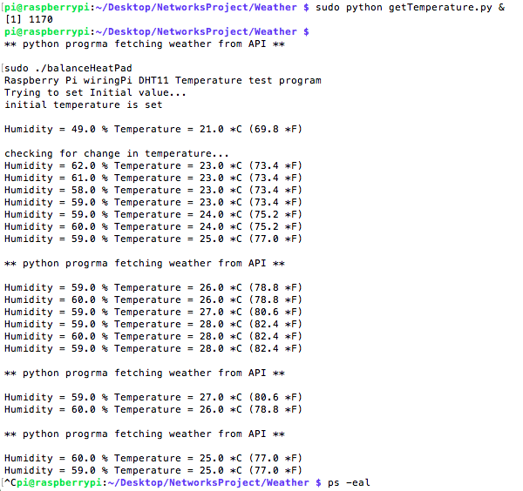
Execution

Slide 14
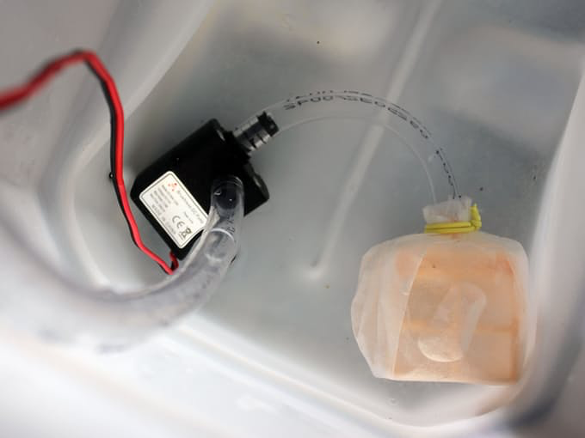
Future Work
Get a water pump to imitate rain
Implement on actual Tank
More heating pads or possibly a better one
Fix Transistor problems
Configure API request into initial program

Slide 15
Possible Uses
Easier Maintenance for Captive animals
Meteorology research
Environmental research

